Slide 1
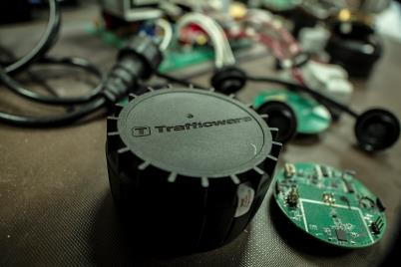
The Trafficware Pod
As a Means of Collecting Purdue High Resolution Data
The Pod
Technical Training
The Pod
Bill Ische, Business Development Manager Chris Jannace, Detection Specialist 03 September 2015

Slide 2
Agenda
Components review
TSI review and planning considerations (Pod placement, spacing, antenna ranges)
Installation
Brackets and materials required
Antenna set-up possibilities / location constraints
Wiring – diagrams & hands-on
Drill equipment / Installation instructions (videos)
Software programming (best practices)
Requirements and time considerations for changes to active systems
Reports & Troubleshooting

Slide 3
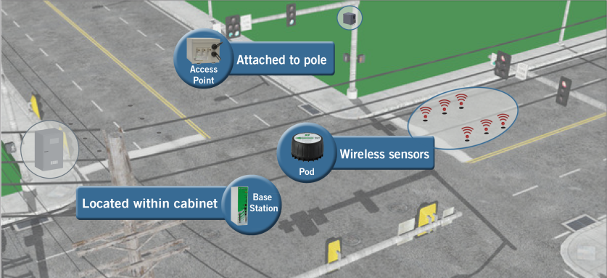
Components

Slide 4
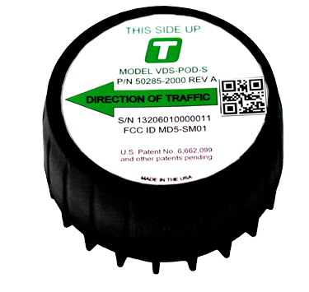
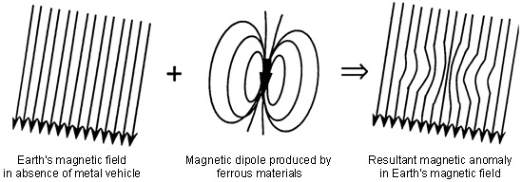
Components Pod Sensor
900 MHz Communication
6’ x 6’ Detection Area
10 Year Battery Life
700 detections per hour (24/7)

Slide 5
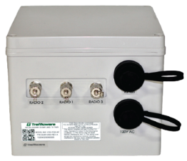
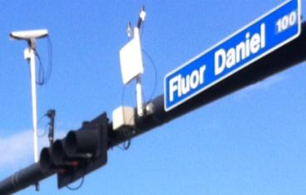
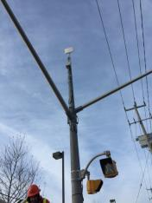
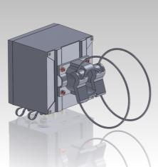
Components Access Point
120VAC
Wireless (internal) or Wired Communication
3 Radios (external)
Box designed to fit articulating style bracket (comes with Access Point kit)

Slide 6
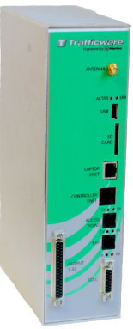
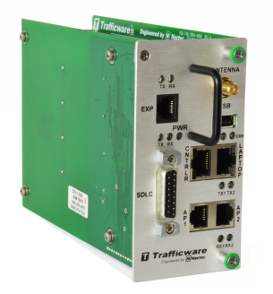
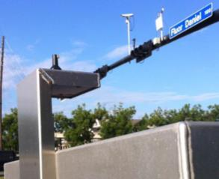
Components Base Station
ZigBee standard compliant encryption used between Base Station and Access Point
Can communicate effectively with two Access Points
Browser-based GUI (You own the Base Station, You own the GUI)
SDLC or parallel wiring connection to controller / cabinet based on configuration

Slide 7
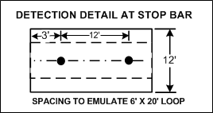
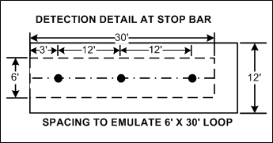
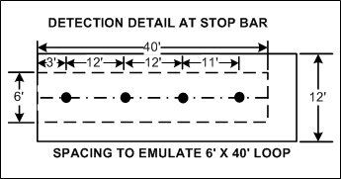
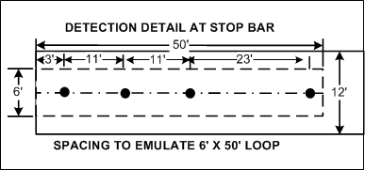
Detection Zones Pod Spacing

Slide 8
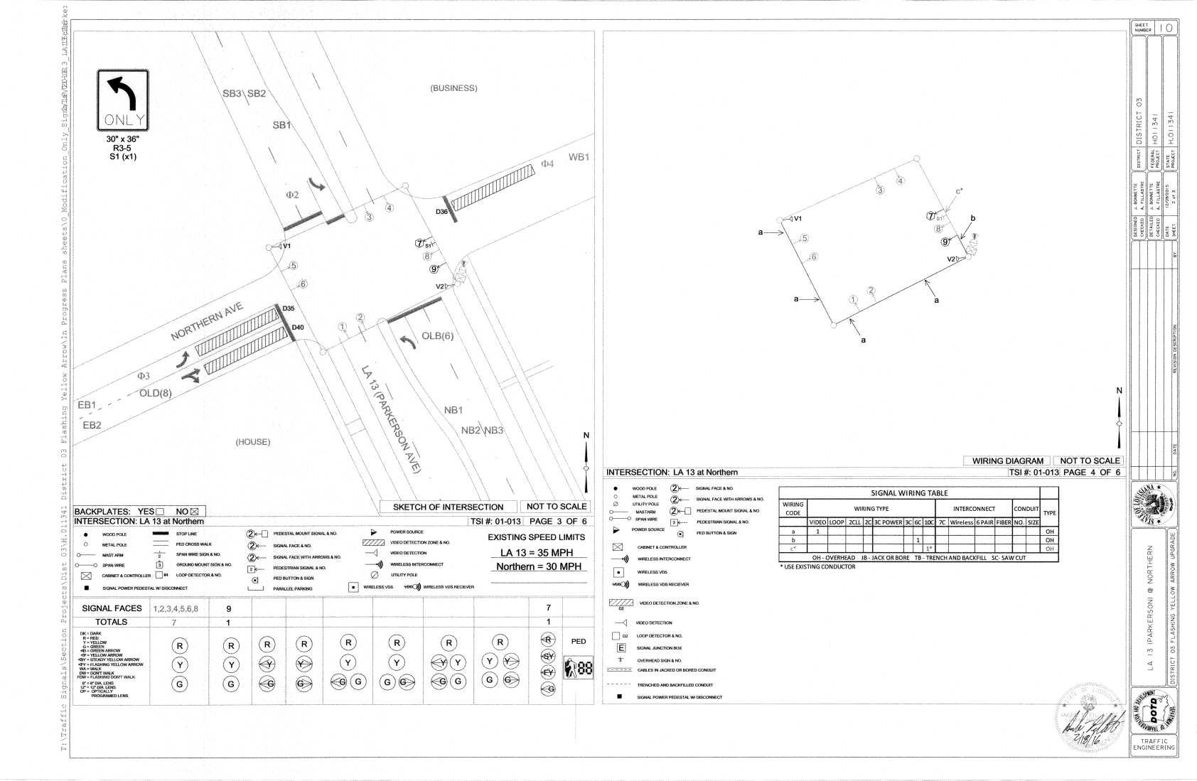
TSI Review & Planning Considerations
*** Go to Google Earth to review ranges

Slide 9
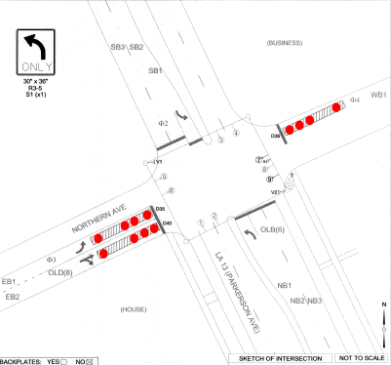
TSI Review & Planning Considerations

Slide 10
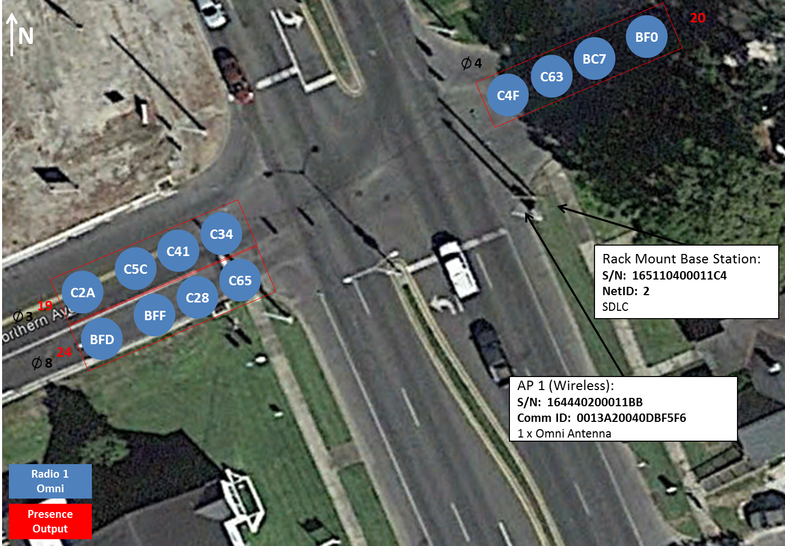
TSI Review & Planning Considerations

Slide 11
TSI Review & Planning Considerations Ex. 2
Up to 30 high-volume Pods per Radio
Add Omni or Panel Antenna

Slide 12
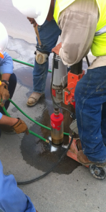
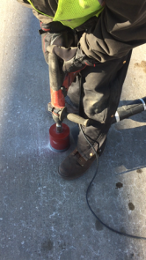
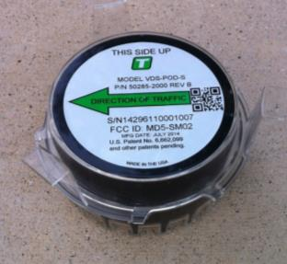
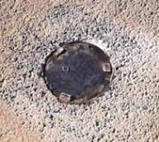
Pod Installation
Core Drill 4.5 inch diameter Hole 2.75 inches deep
Diamond core needs water, Slower
Percussion Core Drill faster, No water necessary

Slide 13
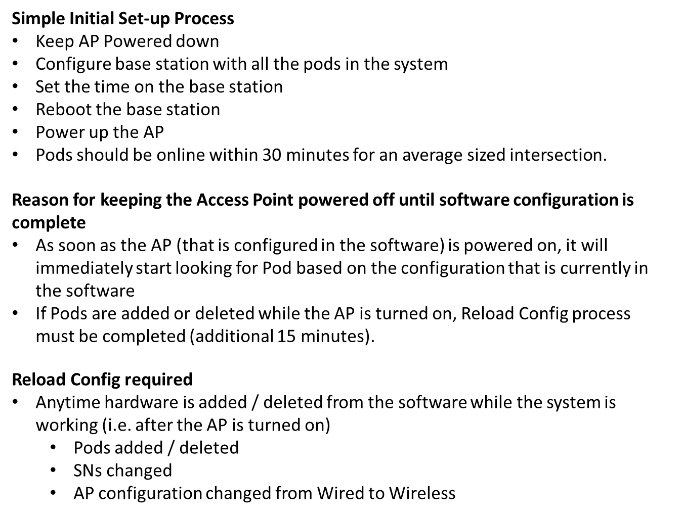
Software Programming Set-up Tips

Slide 14
Software Programming Computer Set-up

Slide 15
Software Programming Base Station
Cable to Expansion Cards (if not SDLC)
Antenna to top of Cabinet
Serial Number (Sticker)
Cable to Laptop
Cable to Switch / Cell Modem
Cable to Access Point (thru EIA-485 Lightning Suppression Panel
Cable to Controller

Slide 16
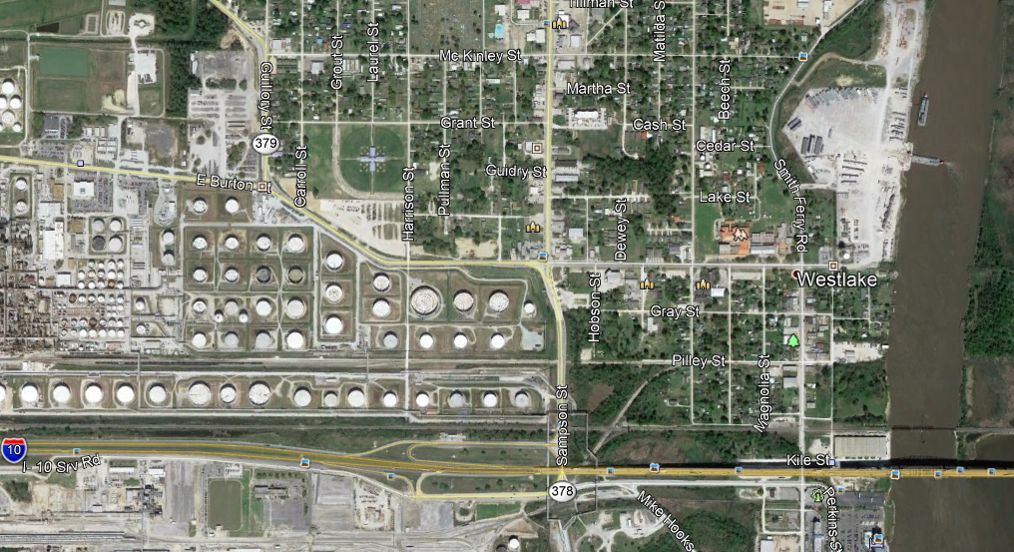
Set-up Tips Net ID / Access Point
Explanation of NetID effects on Access Point Radios
NetID: 5
NetID: 1
NetID: 4
NetID: 2
NetID: 3

Slide 17
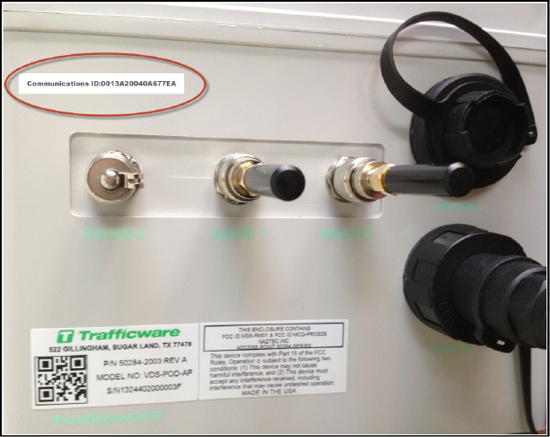
Software Programming Access Point
EIA-485 Cable to Lightning Suppression Panel (Cabinet)
Comm ID
RF Cable to Antennas
Radio 2
(Panel)
Radio 1
(Omni)
Radio 3
(Panel)
Serial
Number
16 awg Cable (Power) to Power Panel (Cabinet)

Slide 18
Software Programming Pod
Mark Pods –
Phase / Direction / Order
(Recommended)
For scanner

Slide 19
Changes – Requirements & Time Considerations
Reload Config
System Reboot – loss of detection for minute
15 minute process (+Pod sync) – constant calls
NetID Considerations
When Required
Base Station NetID change
Access Point replacement
Access Point Communication change
Pod replacement
Pod Add / Delete
Pod Radio change

Slide 20
Troubleshooting
Stuck Pod (Blue) / Unresponsive Pod (Gray)
RSSI / Antennas
Sensitivity – decrease / increase
Reset Sensor (“Learn” button)
Reports – check Vol/Occ for inconsistent performance
No Comm Pod (Yellow)
Serial Number
Reports – check Vol/Occ for inconsistent performance; check Events report for “IncorrectID”
No Comm Access Point (Yellow)
Check Serial Number
Wireless – power, state of antenna
Wired – power, loop back, lightning suppression panel

Slide 21
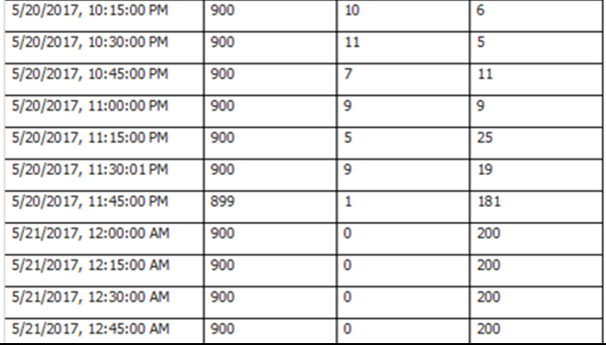
Troubleshooting in Reports
Volume / Occupance Report
*** Find corresponding Events Report information

Slide 22
Troubleshooting in Reports
Events Report
Fix:
Change NetID
Reload Config

Slide 23
Contact Information
Chris Jannace, Detection Specialist
ChrisJannace@trafficware.com
(O) 281-240-7233 x309
(C) 626-261-0875
Areas of Responsibility:
Louisiana
Mississippi
Texas
Arkansas
Oklahoma
New Mexico
Hawaii

